Slide 1
FAS Administrators’ Town Hall – Special Edition
September 25, 2025
Zoom

Slide 2

Export Controls and International Activities at FAS/SEAS
September 25, 2025
Jennifer Towers
Senior Director, Research Compliance Program

Slide 3

Overview
  Regulatory Landscape
  Harvard Policies
  August 2025 Bulletin

Slide 4
Export Control Administrators (ECA) in RCP
Julie Chamberlin
FAS Division of Arts & Humanities/
Social Sciences
Ani Heller
School of Engineering and Sciences (SEAS)
Elizabeth Parsons
FAS Division of Science

Slide 5

Regulatory Landscape

Slide 6
What are U.S. Export Controls?
Laws and Regulations that govern:
The transfer or disclosure of goods, technology, software, services, and funds
Originating in the U.S. Dept of Defense, State, Commerce
To foreign persons/nationals, companies, and nations
Extend worldwide and apply to all components of goods and materials, for their whole lifecycle
Restrict Export of controlled goods and technology that pose a threat to national security and policy interests, as well as transactions of value with sanctioned countries and individuals on Restricted Party Lists (RPL).
For example:
Sharing encryption software with barred research collaborator
Contracting with a foreign person from a sanctioned country for University activities
Processing payments from a Restricted Party for an online education course

Slide 7
What are U.S. Export Controls?
An Export is any oral, written, electronic or visual disclosure, shipment, transfer or transmission of goods, technology, information, or technical data to a Foreign Person.
A Deemed Export is a transfer of controlled goods, technology or information to a Foreign Person within the U.S.
A Foreign Person is defined as:
    A foreign government
    A foreign company or organization
    Anyone who is NOT a:
      U.S. citizen
      U.S. lawful permanent resident (a “green card holder”)
      Person granted asylum, or
      Person granted refugee status

Slide 8
What do we need to consider:
4 Key Questions
What is being shared?
Who is receiving it?
What will it be used for?
Where is it going? (materials)
Regulations apply to “people, places and things” – the individual, company, region, or material can be restricted.
Your Export Control Administrator can help identify any potential exceptions.
“Export” does not necessarily mean out of the country; the concept of “deemed export” is critical.
Deemed Export – when information and “know how” is transferred to a foreign person within the U.S.

Slide 9
How Might Export Controls Impact Activities?
These activities may require a license from a federal agency:
  Sharing technical, confidential or proprietary information with restricted entities
  Providing access to educational materials to students located in comprehensively sanctioned countries, or who are on a restricted party list
  Transfer of funds through banks or individuals on restricted lists
  Presentations of unpublished research at conferences/meetings in comprehensively sanctioned countries
  Visits to HU research spaces by foreign persons
  Contact your ECA to determine need for and apply for a license.

Slide 10

Harvard Policies

Slide 11
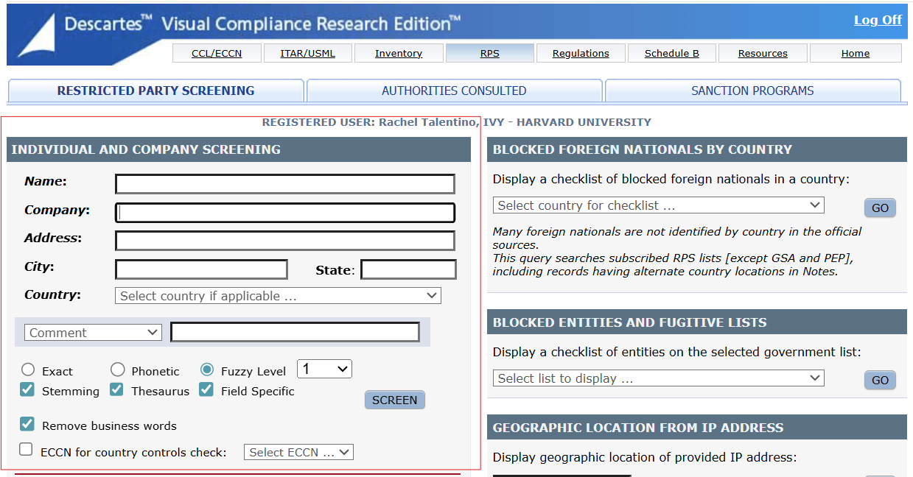
Screening of Restricted Parties
What is a Restricted Party screening?
Restricted Parties List (RPL) screens are conducted using the Visual Compliance software platform, which compares the names of individuals and companies to global information on restricted, denied, and debarred parties.
Individuals on a RPL will result in a “hit” in Visual Compliance.

Slide 12
Screening of Restricted Parties
Faculty, students and staff who engage with (e.g. collaborate or contract with) international individuals or entities must first consult with the School Export Control Administrator (ECA)
Screening is necessary with most international activities, both research and educational
Depending on the risk and location of the activities, additional approvals from OVPR and OGC may be required (for example, Countries of Concern)
    Countries of Concern (COC): China, Cuba, Iran, North Korea, Russia, Syria and regions of Ukraine: Crimea, Donetsk, Luhansk, Sevastopol
    High Cyber Risk Regions: China, Cuba, Hong Kong, Iran, Macao, North Korea, Russia, Sudan, Syria, and regions of Ukraine: Crimea, Donetsk, Luhansk, Sevastopol

Slide 13
August 2025 Bulletin
Harvard Educational Programs include executive and continuing education, not-for-credit summer courses, online/hybrid programs, workshops, conferences, symposia, and other services and events that have an educational component.
What is Required:
Screening of international learners in all online educational programs prior to receipt of payment.
  Currently under discussion with central leadership
Screening of international participants, faculty, co-funders and co-hosts of workshops, conferences, or similar activities hosted, organized, or sponsored in whole or in part by Harvard at an international location
Your Export Control Administrators may ask for additional information to ensure any “hits” in Visual Compliance are appropriately cleared
Restricted Party Screenings for Harvard Educational Programs including Executive Education, Online/Hybrid Education, Workshops, and Conferences.

Slide 14
August 2025 Bulletin
Screening Requests
Email: rcp_exportcontrol@harvard.edu
Include:
  Information/Materials being shared
  Purpose of export/event
  Recipients/Registrants: Full names (no nicknames)
  Current Affiliation/Organization (if N/A, please send country of citizenship/residence)
  Destination/Location
A member of RCP team will perform screen and respond.
What happens when there is a "hit" during a screen?
How long does this take?
What is being shared?
Who is receiving it?
What will it be used for?
Where is it going? (materials)
Restricted Party Screenings for Harvard Educational Programs including Executive Education, Online Education, Workshops, and Conferences.

Slide 15
Questions from the crowd
Why is this happening now?
This has always been the law and a requirement. However, past federal administrations have focused on materials and transactions related to high technology, military and dual-use applications, STEM, Biotech, Medicine, etc.
This current administration has a different focus and all collaborations and work with foreign entities are being scrutinized.
House of Representatives Select Committee on the Chinese Communist Party is performing inquiries into Harvard’s business abroad.

Slide 16
Questions from the crowd
Do exhibitions and educational programs that are free and open to the public require screening?
Restricted party screening of attendees is not required if an event is free and open to the public, as long as:
  Only names and emails, if anything, are collected from participants
  Only general knowledge is disseminated
  No “know how” information is taught/discussed
  Necessary export controls screening related to the content of the event is determined in advance
  Contact your ECA to determine if your content requires export control screening.

Slide 17
Questions from the crowd
Do we accept another institution’s vetting/screening, such as, in the case of co-hosting?
If the institution is foreign, no, we won’t accept it, because we need to use the United States lists for vetting.
If the institution is domestic, we can accept their vetting with proof in writing that it was conducted.

Slide 18
Questions from the crowd
For recurring events with the same participants, is re-screening required? How long is the original screening valid?
Rescreening is recommended for the same participant if the same Harvard employee did not conduct the screening – the administration of keeping lists and cross-referencing could be more time-consuming and costly. Visual Compliance will send dynamic screening updates to the screener’s contact information.
For educational programs, we recommend screening at registration.
For research proposals, we recommend screening at proposal submission, and annually thereafter.

Slide 19
Questions from the crowd
Are materials forthcoming to help explain this topic in more detail?
Yes. OVPR, in conjunction with OVPIA, HUIT, OGC, Deans, etc., is spearheading communications efforts.
The first FAQ should be posted today on the OVPR web site.
RCP will be collating received questions and submitting them to OVPR for additional consideration and future FAQ.
Feel free to reach out to anyone in RCP with additional questions.

Slide 20
Questions from the crowd
How far in advance should screenings be requested and what is the turnaround time for completion?
We would appreciate as much lead time as possible. However, we at least need a few business days lead time.
Typical completion is two to three business days depending on volume, complexity, and results of screenings.
Many requests are handled within one to two business days.
Email: rcp_exportcontrol@harvard.edu

Slide 21
Questions from the crowd
Should we tell people they are being screened and what happens to the data after we provide it to RCP?
Visual Compliance uses publicly available lists in its analyses which are supplied by various federal agencies. Therefore, screening does not require written or verbal consent.
RCP also uses publicly available information from the web in its due diligence.
We keep all emails as a matter of university record. They are stored in the RCP email boxes. We do not share any information with third parties as a matter of practice.

Slide 22
Questions from the crowd
If we have an event happening soon, should we postpone or cancel?
No. In the vast majority of cases, RCP can screen the relevant parties and point you to university resources to help minimize risk.
Set up a meeting ASAP with your ECA to discuss.
Email: rcp_exportcontrol@harvard.edu

Slide 23
Export Control Administrators (ECA) in RCP
Julie Chamberlin
FAS Division of Arts & Humanities/
Social Sciences
Ani Heller
School of Engineering and Sciences (SEAS)
Elizabeth Parsons
FAS Division of Science

Slide 24

Questions?

