Slide 1

Individual Recipients
Robert Bellantuoni
Daniel Bertwell
Allyson Bieryla
Jillian Casey
Emily Crowell
Madeleine Currie
Deborah De Laurell
Danielle Doyle
Irvin Dumay
Jeannette Everritt
Silke Exner
Jason Fleming
Feven Girmay
Erin Holder
Nikki Hughes
Lesley Hunter
Reema Khan
Susan Kinsella
Thomas Lane
Rhea Lesage
Nicholas Majocha
Clayton Mattos
Fanuel Muindi
Mark Palmer
Johannah Park
Alba Perez
Audrey Barker Plotkin
Gertrude Regan
Faith Sutter
Kara-Sue Sweeney
Jane Unrue
Emily Warshaw
David Weimer
Team Recipients
Hutchins Center Events Team
Justin Sneyd
Matthew Weinberg
University Area Indirect Cost Proposal Preparation Team
Charlotte Gallant
Marina Magid
Cara Noferi
Andres Orco-Zerpa
Monica Patel
Undergraduate Advising & Employer Relations Team (Office of Career Services)
Linda Chin
Christiana Cough
Amy DiGiovine
Leanne Gaffney
Loredana George
Tyrene Jones
Daniel Lobo
Marissa Long
Emiko Morimoto
Nicole Satyanarayan
Nancy Saunders
Danielle Zelaya

Slide 2

University-wide recognition program
Celebrates the accomplishments of Harvard staff whose work supports the mission of the university at the highest levels of contribution, impact and excellence
Honorees will be announced in mid-April (nomination window was Feb. 19 to March 8)
Awards ceremony with President Lawrence S. Bacow will be held on June 13 at 3:30 p.m. in Memorial Hall
We welcome you to attend and celebrate Harvard Heroes, especially those FAS recipients

Slide 3
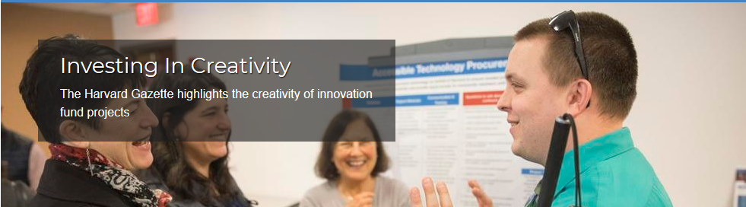
President’s Administrative Innovation Fund
The PAIF was created to catalyze administrative innovation and collaboration across Harvard by investing in staff-generated, creative solutions that support our faculty, students and staff colleagues. Applications due by April 2nd.
Our theme for this year will be “Creating Connections and Community”. Specifically projects that facilitate cross-unit initiatives, that expedite learning across organizational boundaries (both inside and outside of Harvard), and that continue our commitment to diversity, inclusion, and belonging.
Please visit https://innovationfund.evp.harvard.edu/ for details.

Slide 4
Minors Policy Annual Reminder
https://youthprotection.harvard.edu
Compliance with Guidelines for Interacting with Minors, including reporting suspected abuse or neglect
Registration of activities involving minors
Risk mitigation:
  “minors in labs” policy (hazardous environments)
  program administrator training
  background screening and training of any “responsible adults”
Obtaining agreements from lessee organizations
Department Administration Role
Remind unit faculty and staff of Minors policy
Poll your unit regarding presence of minors
Register all minors; contact TSO (jmsheph@fas) with questions
Additional Resources: Please note, Jennifer Shephard, Mary Corrigan and Eliza Brown are available to attend department/lab meetings. Minors will be an agenda item at our next meeting in May.

Slide 5
Welcome, Introductions and General Updates
Leslie Kirwan
Dean for Administration and Finance

Slide 6
Agenda
Welcome, Introductions and Updates | Leslie Kirwan, Mary Ann Bradley
PeopleSoft Time & Labor Changes | Isabelle Modiano, Lisa Lavoie
Faculty Startup Funds | Nancy Guisinger
Accessible Technology Procurement Buy2Pay Supplier Portal Overview Global Support Services | Kyle Shachmut Katherine Gates Krister Anderson, Elizabeth Esparza
Closing / Q & A Session | Leslie Kirwan

Slide 7
Administrative Systems Landscape
Operational/Maintenance Enhancements & Support | Change Management & Implementation | What comes next…
Concur GMAS Harvard Training Portal (HTP) OBI/HART Harvard Careers Harvard Phone Aurora | Spectra Enhancements | I-9/E-verify PI Dashboard Position Tracking & Reporting File Share
PeopleSoft Mobile Changes
Research Administration and Compliance Program/Portal
Buy2Pay- Supplier Portal
B2P - eProcurement

Slide 8

Mark your calendars!
Finance Fundamentals
  Continues through May 8th
  Remaining modules include Budgets, Gifts & Endowments and Procurement
  Attend one or more as a refresher, all six for a certificate
  Please register via the Harvard Training Portal
Admin Ops - ASAP Training Calendar – April, May, June now available
  Chart of Accounts
  Concur
  OBI/HART
  Concur / OBI Tips & Tricks
  Spectra 2.0
  Journals and other YE Prep classes
  Monthly Drop In sessions & more…
Please visit adminops.fas.harvard.edu for additional information

Slide 9
Mark your calendars!
Supplier Portal
  Admin Ops - ASAP is offering two sessions each in April & May
  Project team also offering University-wide training in April
  Job aids and videos to be made available as additional training resources
  Please register via the Harvard Training Portal
PeopleSoft Upgrade
  PeopleSoft Overview class w/Mobile changes May 16th from 10 -11:30 a.m.
  PeopleSoft Mobile changes Drop In session immediately following training from 11:30 a.m. – 12:30 p.m.

Slide 10
Mark your calendars!
Independent Contractors
  Offered by the University Financial Policy Office
  The Independent Contractor (IC) Policy has been revised with an effective date of 7/1/19 (with early adoption encouraged).
  Expanded training materials have been created to help hiring department properly classify and pay these individuals.
  April 2nd from 1:00 – 2:30 p.m. / April 16th from 9:30 – 11:00 a.m. @ CWD
  Additional dates available on the Longwood campus
Please register via the Harvard Training Portal, selecting “Training on the Revised Independent Contractor Policy”

Slide 11
PeopleSoft Time & Labor Changes
Isabelle Modiano
Director, HR Systems
Lisa Lavoie
Associate Director, HR Systems
HUIT, Academic Technology Services

Slide 12
Harvard HR Systems – What’s Next?
Mobile Strategy - “working anytime, anywhere”
Based on our multi-year plans, we are looking at rolling out more mobile (“fluid”) functionality to employees and managers.
Manager Self-Service
Most HR systems are centered around the manager, and modern HR systems rely on the manager for approvals, and enable managers to initiate transactions directly in the application. We are starting to explore moving in that direction.
Less Customization
In order to be able to adopt new functionality more rapidly, we need to customize less. This is an industry trend as cloud vendors are offering more configuration and deploying changes more rapidly.
More frequent and more incremental changes
Harvard’s and PeopleSoft’s strategy is to introduce enhancements and new functionality more frequently and incrementally. In order to continue to improve our user experience, we need to consider how we now approach change, training and communication.

Slide 13
HR Systems – Upcoming changes
PeopleSoft Major Release
PeopleSoft Spring Release: May 13th, 2019
    PeopleSoft will be down Friday, May 10th at 5pm
Release Scope
    Technical Upgrade
    Changes to support the Position Tracking and Reporting project
    New PeopleSoft functionality
      Day One onboarding
      New Mobile Time and Labor pages:
        Timesheet page is replaced by new Mobile Time Entry pages - impacts EMPLOYEES
        Time Approvals are being added to the Approvals Tile, existing page remains unchanged – impacts MANAGERS
        Harvard Exception page is being replaced by a Mobile Exceptions page – impacts ADMINISTRATORS
      New Mobile Direct Deposit page – impacts EMPLOYEES
      New “look and feel” for administrative pages

Slide 14
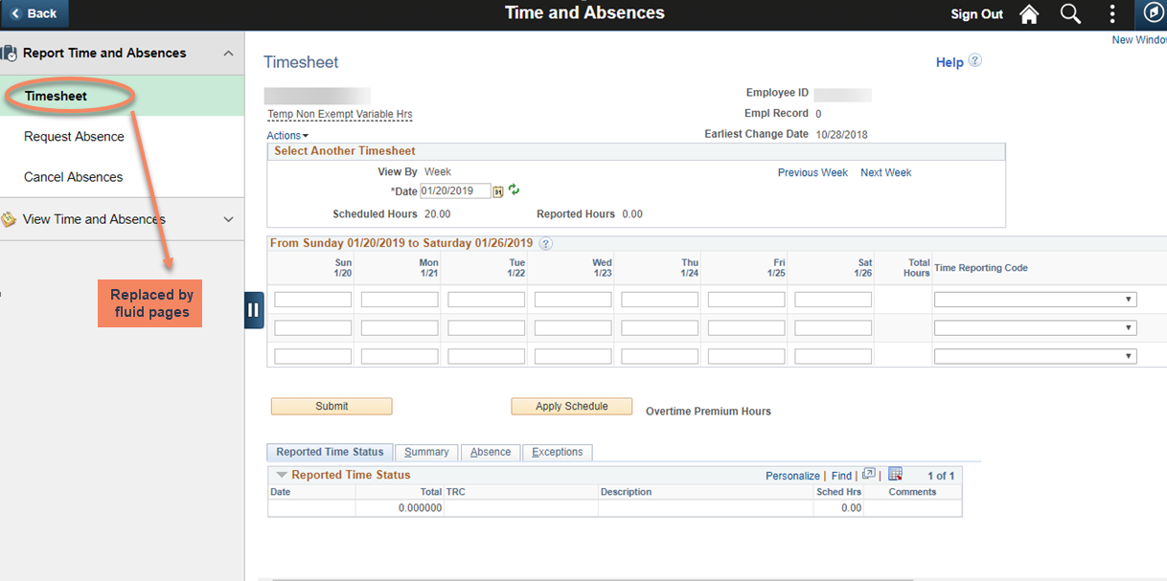
Changes for Time and Labor pages
– Employees
Current
Add print screen of tile here

Slide 15
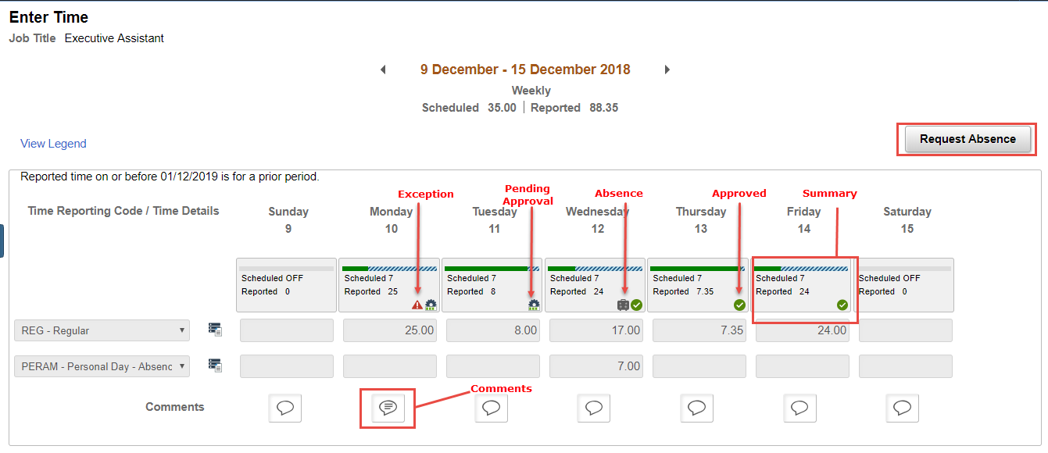
Enter Time (Fluid) – from laptop
New

Slide 16
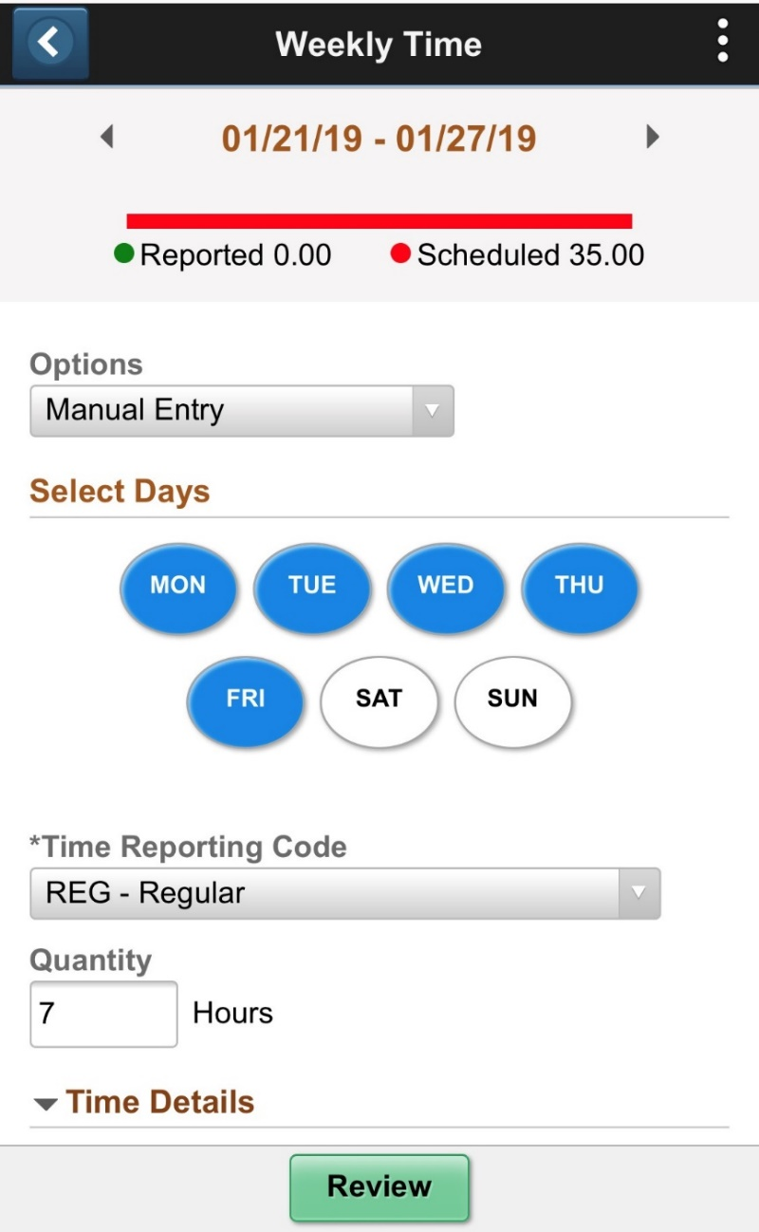
Weekly Time Entry (small form) – from a Smartphone
New

Slide 17
    Mobile Time Entry – Key Changes
Replaces our current timesheet pages available to employees and managers
  Enter Time page will make it easier to report time on laptops and tablets
  Weekly Time Entry page specifically for small devices
Employees will be able to request absences directly from the Time Entry page
Smaller changes may be noticeable to employees:
  Information currently displayed in different tabs will now be icons
  Comp Time is no longer a tab but is accessible on another page
  Comments are by day, not by day and week
  No restrictions to enter time in .25 increments
  No validation on the number of hours reported but manager will see a flag

Slide 18
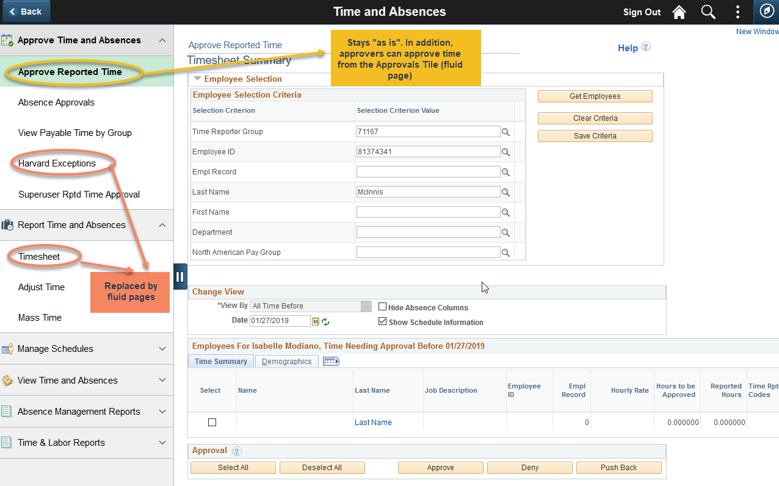
Changes for Time and Labor pages
– Managers and Administrators

Slide 19
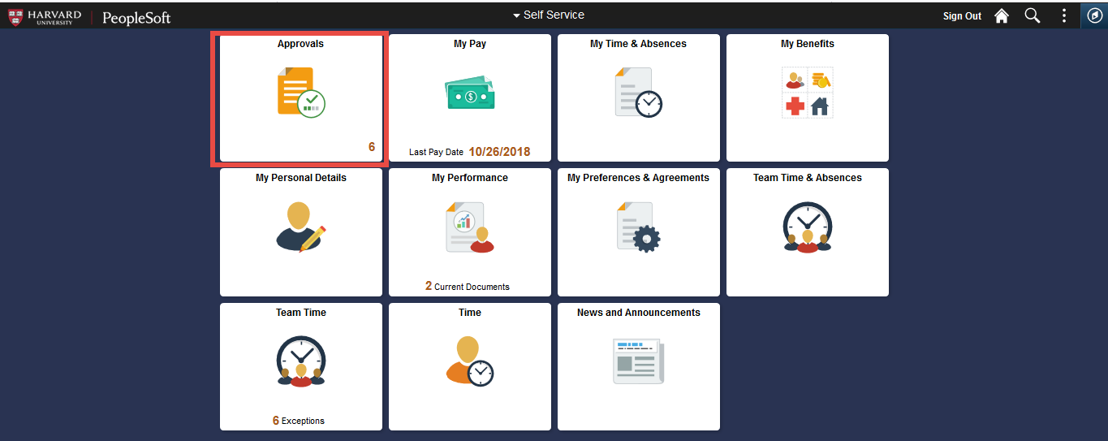
    Mobile Time Approval

Slide 20
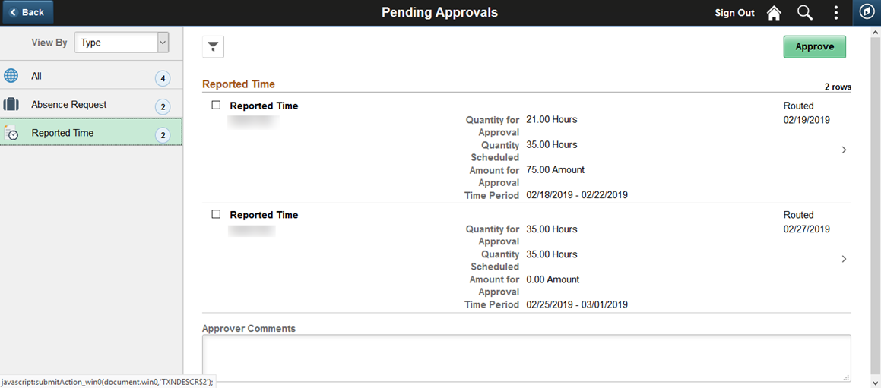
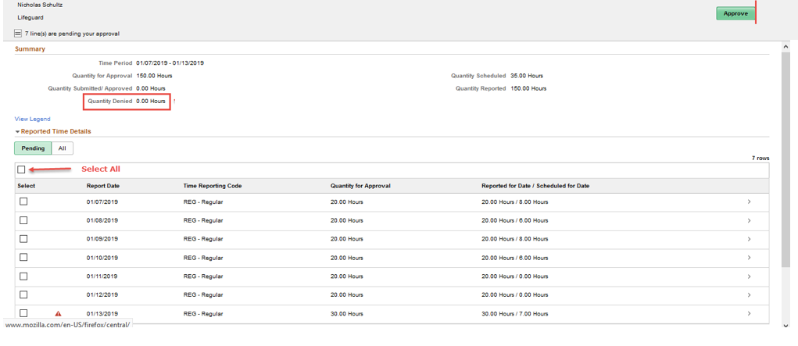
    Mobile Time Approval
New

Slide 21
    Mobile Time Approval – Key Changes
Time Approvals will be on the same “Approvals Tile” as Absence Approvals
Easier to use, with same access to details as before
Ability to select multiple rows and approve with a single click
Important: we are keeping the Approved Reported Page for now (primarily for admins)

Slide 22
    Communication Plan
Time and Labor Changes
Working closely with all our user groups from all schools
Conducted User Acceptance Testing with 40-45 people from across the University
We will include an announcement in the eNews
We are working with CWD on a training video for the new Time Entry pages
We will notify via email all time reporters about the new page
Other Changes
Day One Onboarding - communication handled by CWD and the Advisory Group
New Direct Deposit Page – no communication, the new page is easier to use

Slide 23
    Feedback? Questions?

Slide 24
Appendix: Changes for Time and Labor pages– Summary
Current Time & Labor Page Name | New Time & Labor Page Name | Page changing? How? | Who’s Impacted
Timesheet | Enter Time | Yes, the Timesheet page will be replaced by the Enter Time and Weekly Time Entry. If the employee is on a mobile device they will automatically be transferred to the Weekly Time Entry page. | Time Reporters (all hourly employees) and Managers
Timesheet | Weekly Time Entry | Yes, the Timesheet page will be replaced by the Enter Time and Weekly Time Entry. If the employee is on a mobile device they will automatically be transferred to the Weekly Time Entry page. | Time Reporters (all hourly employees) and Managers
N/A | Approvals | Fluid Approvals tile will now include the ability to approve Reported Time. | All Time Approvers (Managers and Time Administrators).
Approve Reported Time | Approve Reported Time | No changes | Department Administrators and Time Administrators.
Adjust Time | Adjust Time | No changes | Department Administrators and Time Administrators.
Harvard Exceptions | Manage Exceptions | Yes, the classic Harvard Exceptions page will be replaced by the fluid Manage Exceptions page. No filters we be applied: all Exceptions will be displayed. | Department Administrators and Time Administrators.
All other pages |  | No changes

Slide 25
Faculty Startup Funds
Nancy Guisinger
Assistant Dean for Finance & Controller
FAS Office of Finance

Slide 26
Faculty Start Up Accounts
Current:
  Several Faculty Start Up Accounts that are Unrestricted Undesignated Fund Types
Beginning in FY20:
  One Faculty Start Up Account that is Unrestricted Designated Fund Type.
This change will increase
Efficiency, Accuracy and Transparency
of Faculty Start Up Accounts with no impact to Financial Results
New Fund Number: 016110

Slide 27
Impact
Disable
Back Office
Open POs will need to be closed and new POs with new Fund will need to be opened
Finance/Admin Ops will update Payroll, Concur and PCard defaults
Fund Number
There will be a new Fund Number to use. Fund 016110
POs
Internal Billings & Service Centers costing strings will need to be updated
Billings
Old Start Up Funds 000770, 000772 & 000775 will be DISABLED in July

Slide 28

Help with Transition
Faculty Start Up Deficits are defined as the aggregate of 000770, 000772, 000775 and 016110. Fund Management Customization will be shared with DAs to identify deficits.
Transaction Listing
PI Dashboard
Transaction Listing Customization created by Admin Ops will be shared with DAs to aggregate 000770, 000772, 000775 and 016110.
Deficits
Accounts with 000770, 000772 and 000775 will be updated to also include 016110.

Slide 29

Timing
June
Payroll, PCard and Concur defaults updated
PI Dashboard Accounts added
Transfer Balances to 016110
Now
Purchase Assets with 016110
Internal Billing review to get updates in place
Purchase Orders going into FY20, use Fund 016110
July
Old Funds will be disabled
PI Dashboard Accounts with current Start Up will be updated to include 016110

Slide 30

Questions/Comments/Feedback

Slide 31
Faculty Start Up Accounts
Beginning in FY20:
  One Faculty Start Up Account that is Unrestricted Designated Fund Type.
New Fund Number: 016110

Slide 32
Accessible Technology Procurement
Kyle Shachmut
Manager of Digital Accessibility
University Disability Services

Slide 33
today’s discussion
1
what is accessibility?
definitions, demonstrations & discussion of barriers created by inaccessible technology
2
accessibility in procurement
considering accessibility when purchasing technology
3
accessibility resources
use & share guides when your department makes technology purchases

Slide 34

what is accessibility?
digital accessibility — making electronic content available to and usable by everyone [at the same time, with the same ease of use], including and especially people with disabilities

Slide 35



diverse, welcoming & inclusive for all
students, faculty,
staff & others
physical
environments
digital
environments

Slide 36
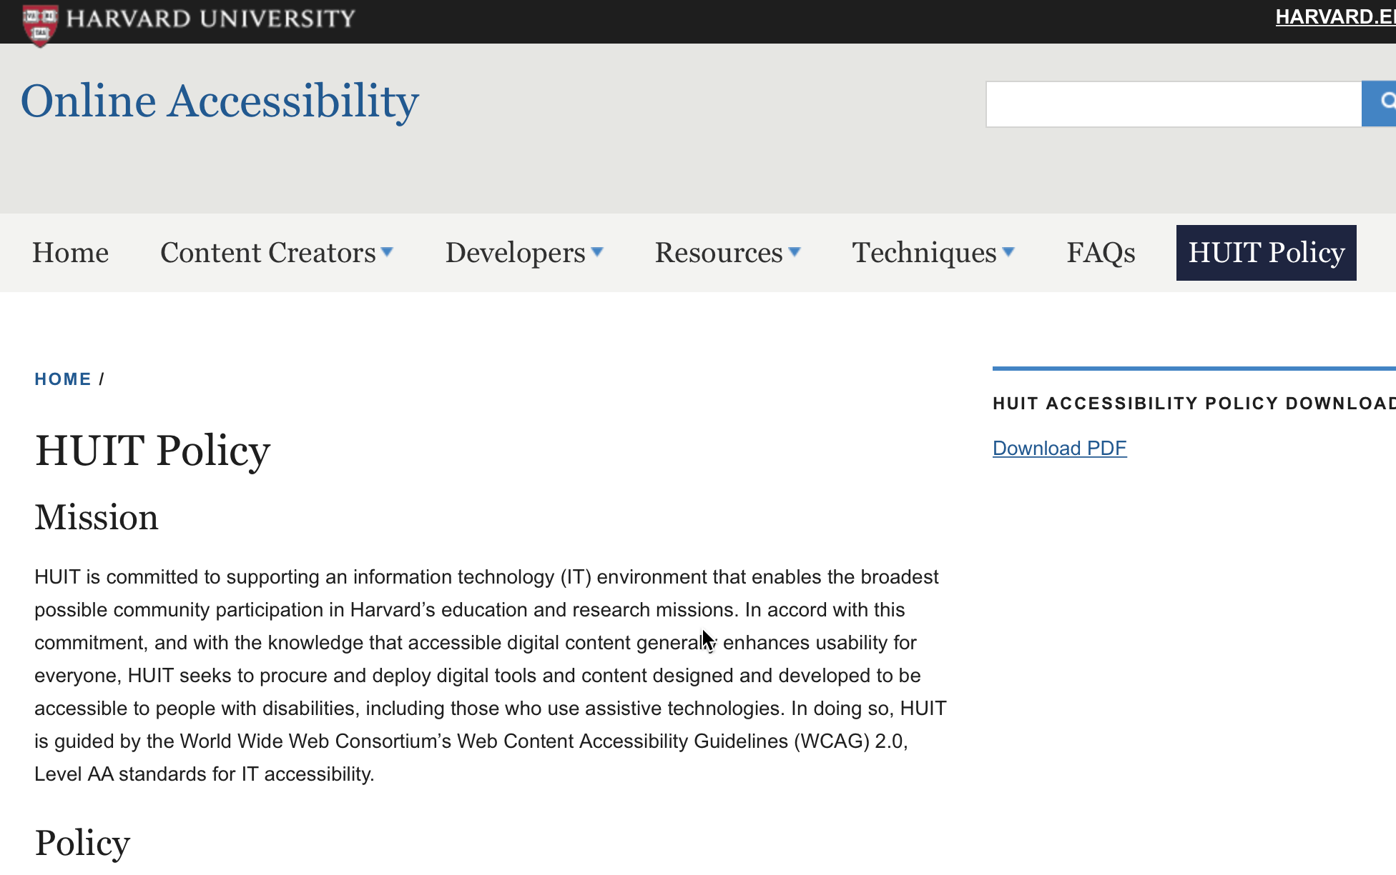
HUIT Accessibility Policy
central IT has a online accessibility policy stating technology developed or procured should adhere to the WCAG 2.0 AA standard
accessibility.huit.harvard.edu

Slide 37



Pathways to Accessibility
ensure accessibility through process
contract
rider
roadmap
to access
exception
process

Slide 38
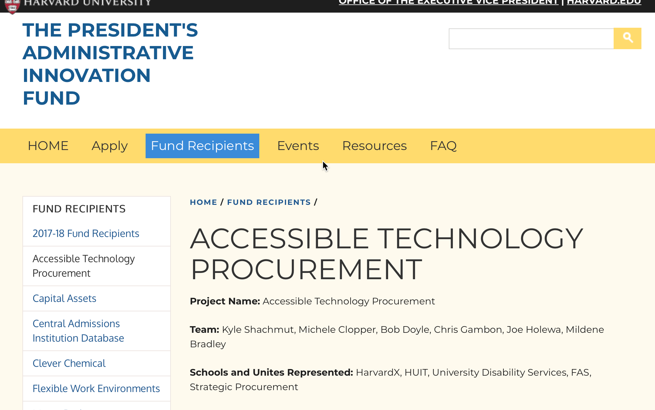
president’s administrative innovation fund
The President’s Administrative Innovation Fund was created to catalyze administrative innovation and collaboration across Harvard by investing in staff-generated, creative solutions that support our faculty, students and staff colleagues
2017-18 PAIF-ATP team:
Kyle Shachmut
Michele Clopper
Bob Doyle
Mildene Bradley
Chris Gambon
Joe Holewa
HarvardX - UDS - HUIT
University Disability Services
FAS & Assistive Tech Center
HUIT, Admin Technology
VPF-Strategic Procurement
HUIT-Vendor Management
innovationfund.evp.harvard.edu/accessible-technology-procurement

Slide 39
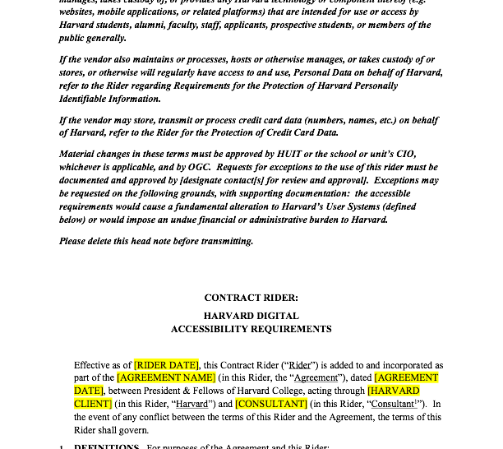
Harvard digital accessibility contract rider
1.5 page contract rider from OGC’s model document website
ensures vendors will deliver tech to WCAG 2.0 AA
vendor will test & maintain accessibility conformance
make reports available to Harvard
demonstrate progress on issues
ogc.harvard.edu/pages/model-documents

Slide 40
Pathways to Accessibility
ensure accessibility through process
contract
rider
roadmap
to access
exception
process

Slide 41
accessibility data in Novatus
questions asked and available for reporting
accessibility addressed in contract?*
Is there a signed accessibility rider?
where is the accessibility rider?
Is there an accessibility roadmap for this product?
if roadmap, create Novatus events for key deliverables
has an exception been granted for this contract?
approver of waiver + documentation location
did the vendor provide a VPAT?
location of the VPAT
How was this product reviewed for accessibility?
  q & a with the vendor; automated tools, assistive technology user testing; product not reviewed
when was the product reviewed?
share results from the product review
  if available, free text or report documents uploaded from #10-11
process overview and supporting documents at: accessibility.huit.harvard.edu/procurement-process

Slide 42
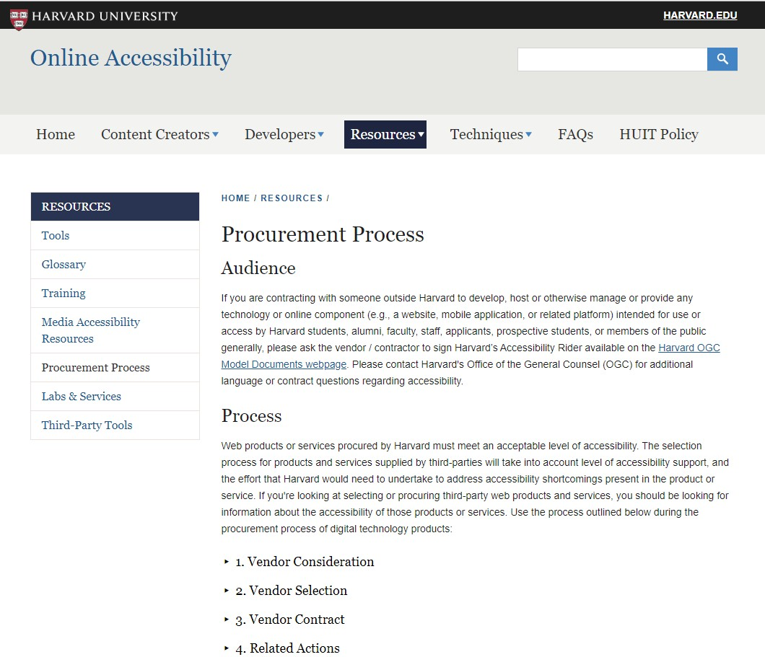
resources & info
RFP & Contract Templates – To find templates with standard Harvard questions and terms, visit the Online Accessibility website
Send signed contracts to: huitvm@harvard.edu
Email digital accessibility questions to: disabilityservices@harvard.edu
accessibility.huit.harvard.edu/procurement-process

Slide 43

Accessible Technology Procurement
Questions?
Kyle Shachmut
HUIT
HarvardX
University Disability Resources
kyle_shachmut@harvard.edu

Slide 44
Buy2Pay Supplier Portal Overview
Katherine Gates
Senior Director of Planning and Administrative Initiatives
FAS Administrative Operations

Slide 45
Buy2Pay Overall Project Timeline
FY19
FY20
Design & Configuration, Validation, Testing & Training
Phased Go-Live Rollouts
DESIGN, BUILD, INTEGRATE & TEST SOLUTION
TRAINING DEVELOPMENT
COMMUNICATIONS & TRAINING DELIVERY
POLICY AND PROCESS ALIGNMENT
PHASED GO-LIVE ROLLOUTS
Supplier Portal
04/29/19
CHANGE MANAGEMENT & ORGANIZATIONAL READINESS

Slide 46
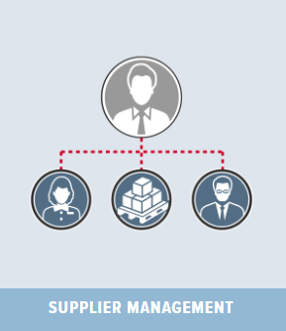




Buy2Pay Module Definitions
Buy2Pay Solution
Single platform that simplifies, streamlines, and removes guesswork in the procurement process
The Supplier Portal allows suppliers to enter and maintain their contact, tax and payment information and also accommodates white glove registration by departments. This module automates some compliance checks, including debarment, and offers robust search features for users.
SUPPLIER
MANAGEMENT
A centralized module for procurement sourcing actions required by financial policy such as soliciting bids, tracking RFPs, and awarding contracts. Used in conjunction with Buy2Pay reports and analytics, this module could potentially help the university recognize cost savings through strategic supplier sourcing.
SOURCING
A contract database and end-to-end management tool. Users can automate the authoring, redlining and signing of contracts and/ or store executed contracts. Users can receive alerts about upcoming contract renewals or actions.
CONTRACTS
This module guides users through the buying process in the marketplace or for non-catalog items and gives users visibility into available and preferred supplier options. Users can link PO information to other modules, route invoices, and track payment status.
ePROCUREMENT
This module provides reporting and analytics to assist central procurement and schools in analyzing their spend with particular suppliers or types of spend categories. The University could potentially recognize savings through negotiating volume and early payment discounts, and leveraging campus-wide buying power.
SPEND
ANALYTICS

Slide 47

What is a Supplier?
A supplier is an
individual or company
that provides
goods or services
to Harvard

Slide 48
Supplier Portal Deployment Strategy
The Supplier Portal allows suppliers to enter and maintain their contact, tax and payment information and also accommodates white glove registration by departments. This module automates some compliance checks, including debarment, and offers robust search features for users.
SUPPLIER
MANAGEMENT
Supplier Portal will go live university-wide on April 29, 2019
Allows users to begin to realize our expected benefits sooner
The Supplier Portal is the building block for rolling out other modules - need Suppliers for Contract and Sourcing modules

Slide 49
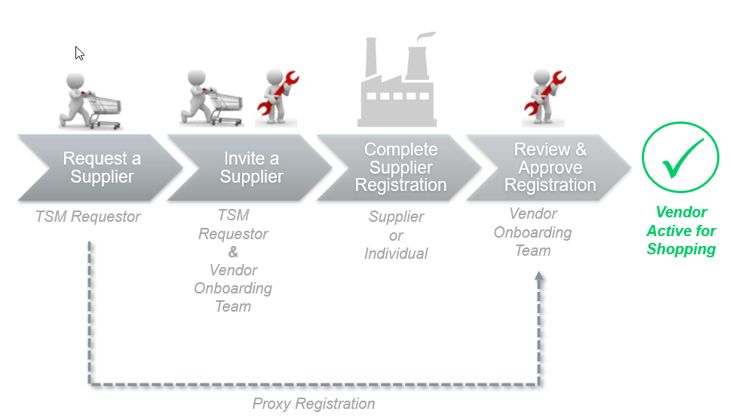
Supplier Portal Workflow
*
Department approvals are no longer needed on vendor requests.
TSM stands for Total Supplier Management (the module name)

Slide 50
Next Steps for Departments
Look for email with list of current HCOM Requestors and Approvers and their transaction volume in early April
Determine which staff should have Requester access to the supplier portal
  No Approver role like in HCOM
  Requesters will be responsible for entering in supplier names and email addresses for invitations or completing proxy registrations
  Potential to reduce number of users in departments
Encourage Requesters to attend recommended FAS Supplier Portal training coming in April 2019

Slide 51
Global Support Services
Krister Anderson
Senior International Program Consultant
Elizabeth Esparza
Senior Program Manager
Global Support Services

Slide 52
About Harvard global support services
Harvard Global Support Services (GSS) offers international travel, research, and programming support for students, faculty, and staff across Harvard’s Schools, Departments, and centers.
Since 2011, we have helped the Harvard community minimize risk, manage complexity, and maximize the impact of their international travel and activities.

Slide 53

A WORLD OF EXPERTISE
Safety and security
Health
Culture
International SOS
Outbound immigration
Employment
Financial and Legal Matters
Research center operations

Slide 54
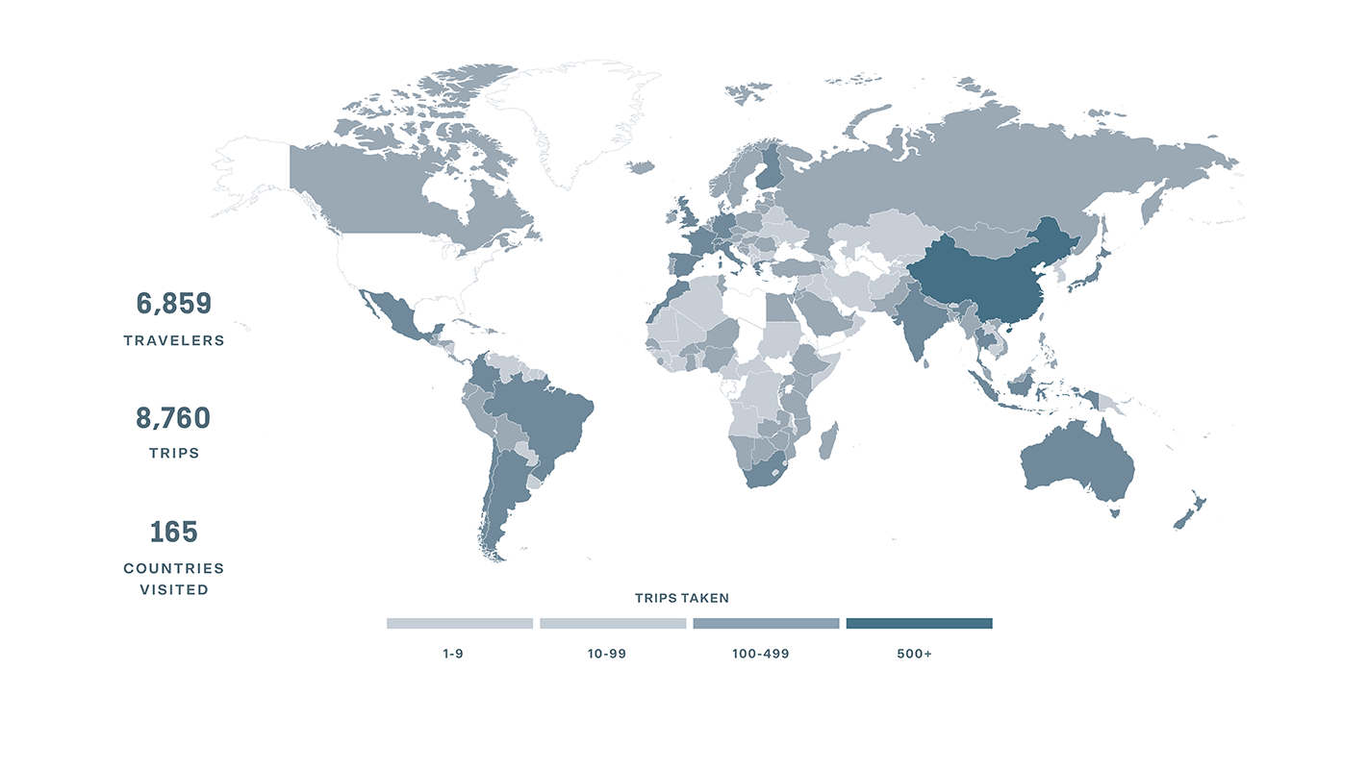
Travel by the numbers

Slide 55
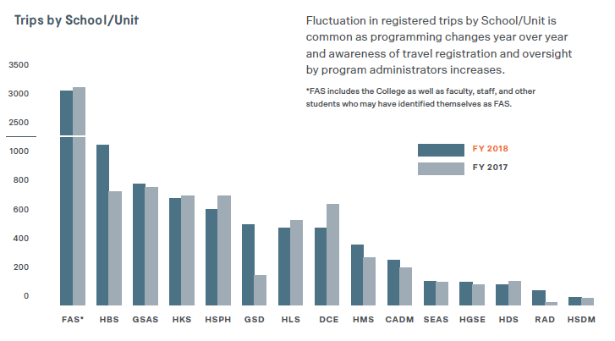
Travel by the numbers

Slide 56

International Safety and Security
Zeb Goodman 16, Denmark

Slide 57

International sos
International SOS is the market leader in global medical, mental health, and travel security for higher education, and our vetted partner for emergency response. The services are available to eligible students, faculty, and staff who are traveling or working overseas on behalf of Harvard.
Key capabilities and services
Routine and emergency advice, assistance, and evacuations
24/7 hotline: +1-617-998-0000
MyTrips travel registration platform: globalsupport.harvard.edu/mytrips
Proactive incident communications
Mobile app with country guides, alerts, and real-time check-in and chat features

Slide 58
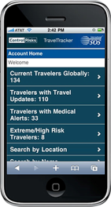

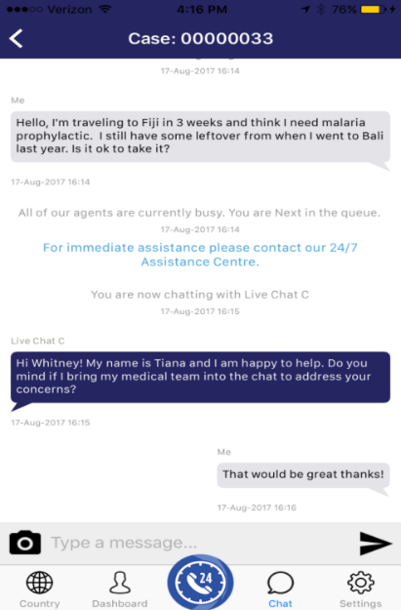


HARVARD GSS
International sos → Mobile App
CALL FOR ASSISTANCE
One-touch dialing for routine advice and emergency support
The call is directed to an International SOS assistance center.
CHECK IN
Travelers can ‘check in’ so we know where they are in case of an emergency.
GLOBAL INFORMATION
Special advisories that affect multiple regions around the world
Download the app: app.internationalsos.com

Slide 59
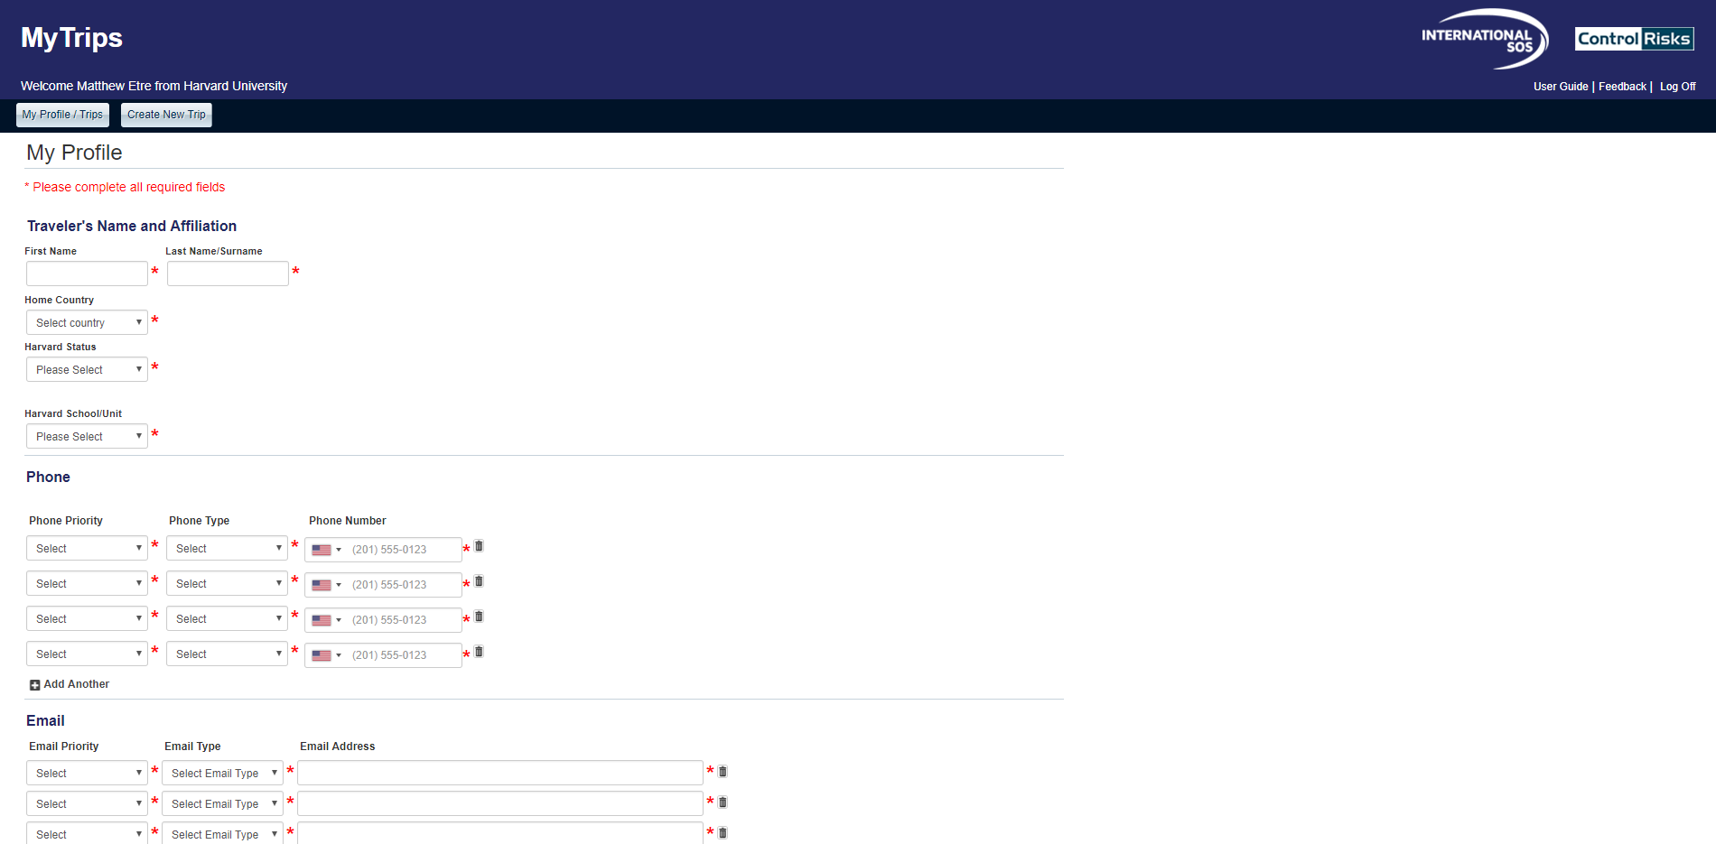
International sos → MyTrips

Slide 60
Discover a world of opportunity
Find out more about how GSS can help get you exactly where you want to be.
Contact Us
+1-617-495-1111
globalsupport@harvard.edu
globalsupport.harvard.edu
INTERNATIONAL SOS
Register travel
MyTrips
Emergencies abroad
+1-617-998-0000
Mobile app
International SOS Assistance app
Available from the Apple, Android, and Windows app stores

