Slide 1
Administrators’ Town Hall will be starting soon…

Slide 2
Rules of the Road for today’s meeting:
Attendees are asked to stay on mute with video off to preserve meeting bandwidth.
Presenters will be off mute and on video during their presentations.
If you have a general question that you think others would benefit from, please use the chat to send a message to “Everyone”.
Q&A is not a forum for specific questions. If you have a specific question, please follow up with one of the subject matter experts.
Please note: The chat from this meeting will be saved to help update future FAQs. We will not be distributing the chat transcript.

Slide 3
FAS Administrators’ Town Hall
May 21, 2020
Zoom

Slide 4
Agenda
Welcome | Leslie Kirwan
FAS Planning COVID Workgroups | Michael Burke
Financial Update | Leslie Kirwan, Jay Herlihy
Human Resources | Chris Ciotti
Research Administration | Pat Fitzgerald
Facilities | Zak Gingo
Administrative Operations | Mary Ann Bradley
Closing / Q & A Session | Leslie Kirwan

Slide 5
Welcome
Leslie Kirwan
Dean for Administration and Finance

Slide 6
FAS COVID-19 Planning
Michael Burke
Registrar, Faculty of Arts and Sciences

Slide 7
Phases
De-Densify (March): remote working, teaching, learning
Phase 1 planning (March to April): all schools presented various scenarios for summer and fall to the University
Phase 2 planning: how do we resume the academic enterprise in these new circumstances in the fall and beyond?
  How to resume courses in the fall
  How and when to bring staff back to the workplace
  How and when to restart on-campus research
  Longer term impact through entire crisis and beyond
Preparations based on decisions

Slide 8
Phase 2 Planning
FAS Coordination Planning Committee with 12 work groups
  Decision framework – Chris Stubbs and Mike Burke
    Decision flow diagram and framework
  Five-year horizon – Maya Jasanoff
    Consider five-year perspective, advise on longer term impacts of AY 20-21 decisions. Provide a vision for where Harvard College is headed.
  Financial Planning – John Campbell
    Establish framework for strategic financial planning. Evaluate fiscal impacts of fall scenarios.
  Go for Fall – Mike Burke
    Determine what it would take for fully residential program in AY 20-21. Explore low-density and surge housing options.

Slide 9
Phase 2 Planning
FAS Coordination Planning Committee with 12 work groups
  Restarting scholarship – Chris Stubbs
    Determine process for staged return to on-campus scholarship.
  Houses and facilities – L. Mahadevan and Zak Gingo
    Determine what we need to do in order to prepare undergraduate houses and other facilities.
  Enrollment – David Laibson
    Advise on interplay between offerings, deferrals, tuition and related issues.
  Scheduling – Jay Harris and Erika McDonald
    Consider how to best use both the 12-month academic calendar and 24 hour classroom schedule.

Slide 10
Phase 2 Planning
FAS Coordination Planning Committee with 12 work groups
  Testing and Tracing – Mark Fishman and Latanya Sweeney
    Advise on viral and serological testing, and contact tracing methods.
  Remote Experience – Amanda Claybaugh
    Coordinate Harvard College efforts on preparing for the remote elements of AY 20-21, including both formal courses and extra-curricular aspects.
  Division of Continuing Education Coordination – Henry Leitner
    Coordinate with DCE in planning for various scenarios, and help us leverage DCE’s experience in remote education.
  Communications – Nina Collins and Anna Cowenhoven
    Advise and coordinate communication efforts

Slide 11
Phase 2 Planning
When:
  Planning now
  Preparing for remote teaching 2.0 ongoing
  Research resumption next
  Plans for fall semester by end of June/early July
Learn more: https://www.fas.harvard.edu/fas-fall-2020-planning
Provide input: FASscenarioplanning@fas.harvard.edu
Reach out: Contact Chris Stubbs or Mike Burke

Slide 12
Financial Updates
Leslie Kirwan
Dean for Administration and Finance
Jay Herlihy
Associate Dean for Finance

Slide 13
Human Resources Update
Chris Ciotti
Associate Dean for Human Resources

Slide 14
Research Administration Update
Pat Fitzgerald
Associate Dean for Research Administration Services

Slide 15
Facilities Update
Zak Gingo
Associate Dean for Physical Resources and Planning

Slide 16
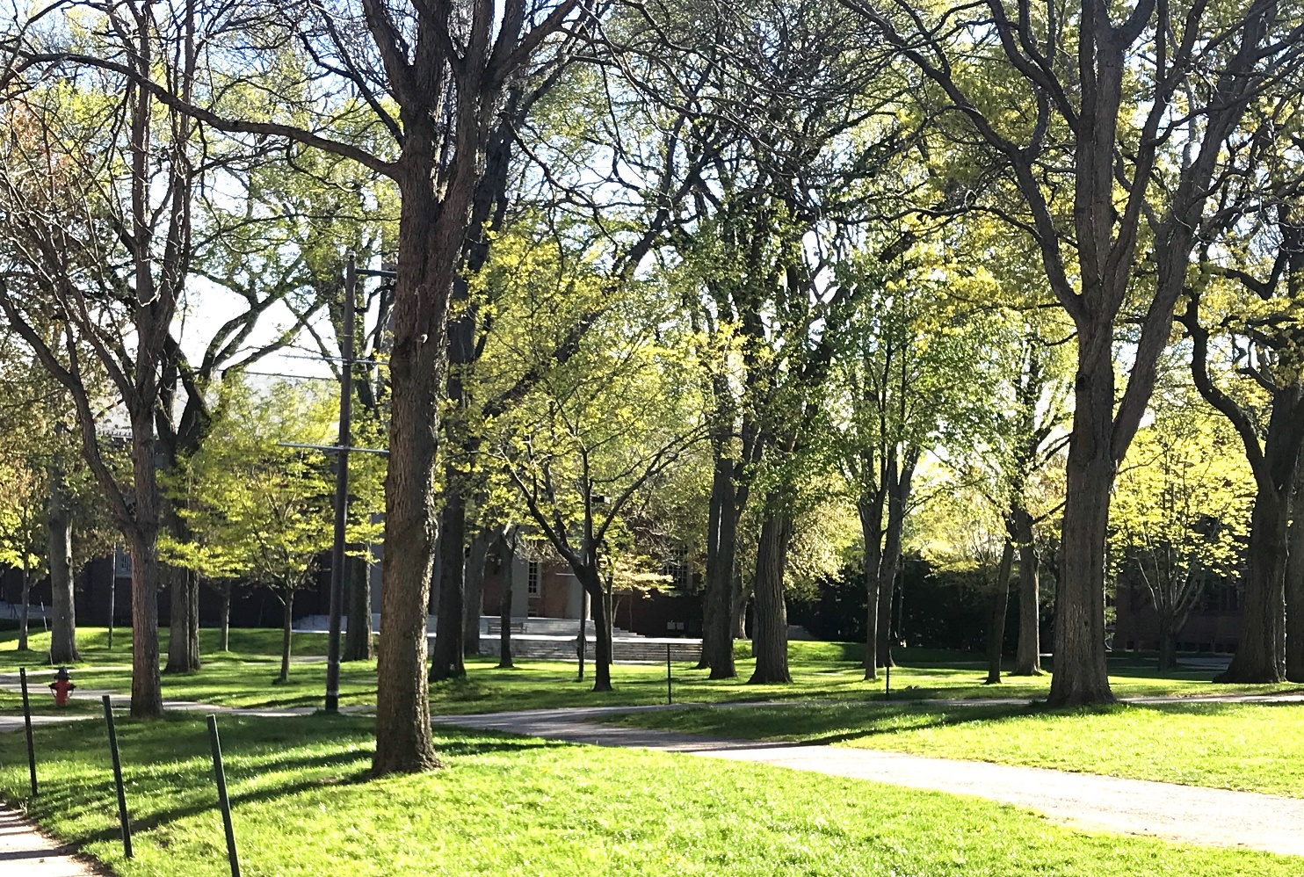
We miss everybody

Slide 17
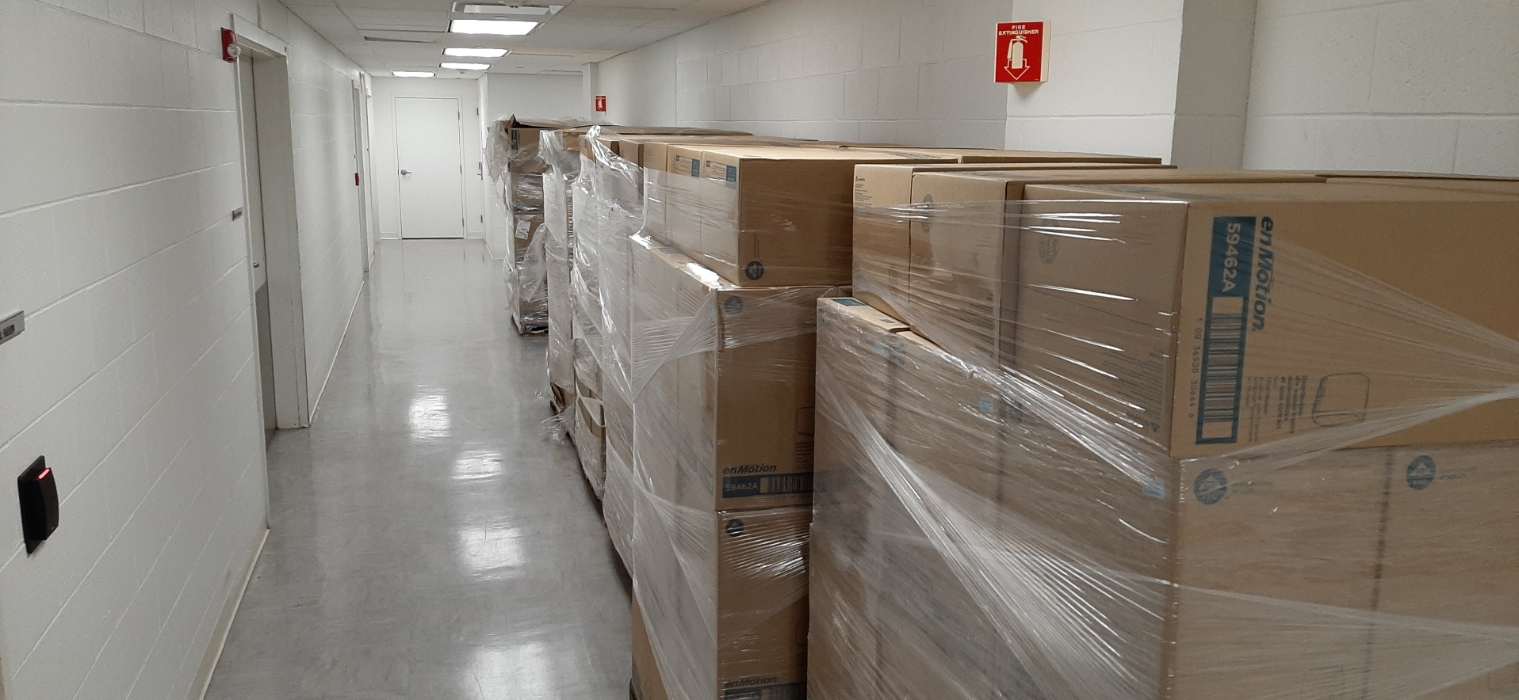
Preparing for the return to campus

Slide 18
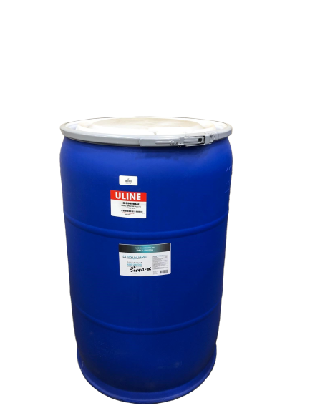
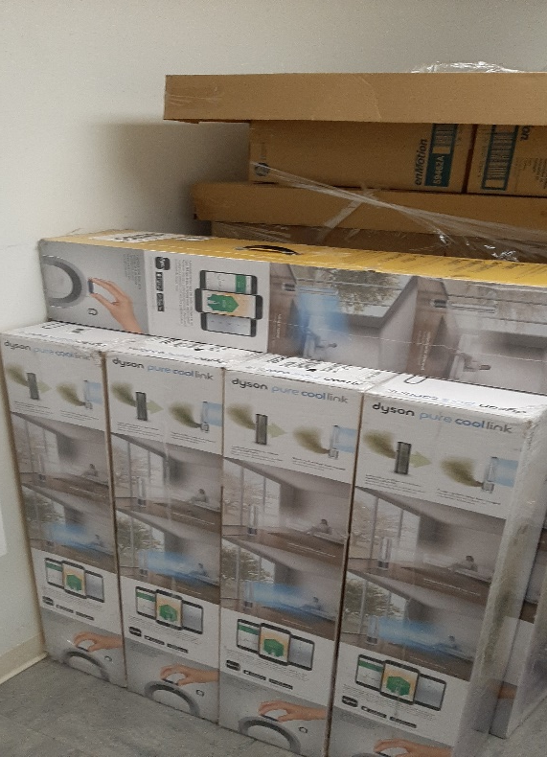
Preparing for the return to campus, continued

Slide 19


You will notice some changes

Slide 20
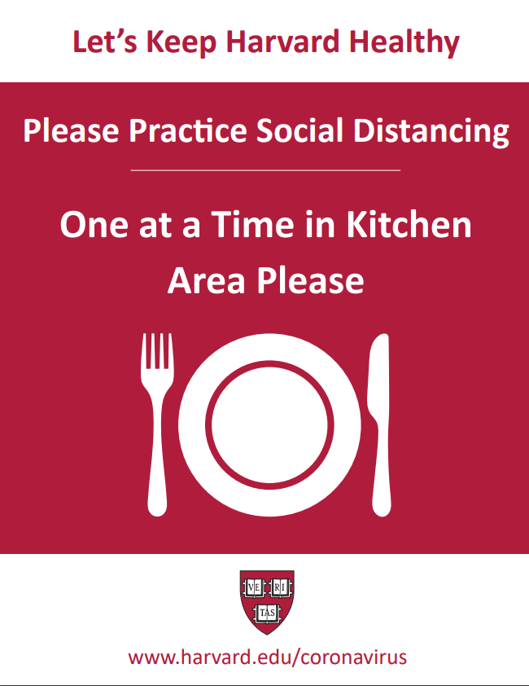
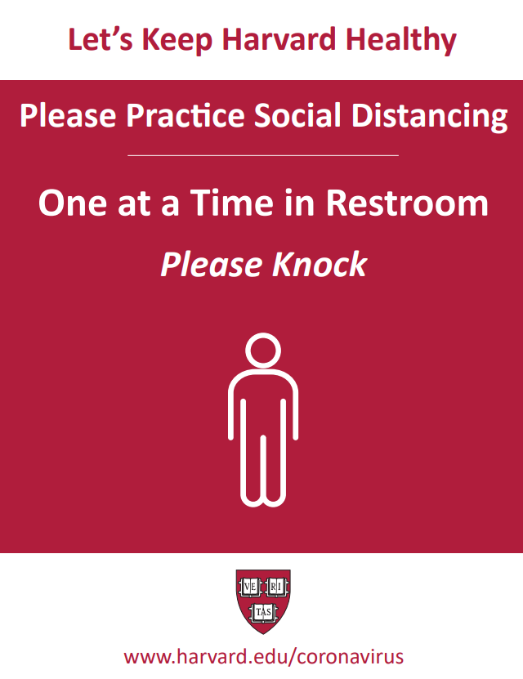
You will notice some changes, continued

Slide 21
Administrative Tools and Support
Mary Ann Bradley
Associate Dean for Administrative Operations

Slide 22
Administrative Systems New Tools
FY 20/21 University Projects Underway | What Comes Next…
Buy2Pay –E Procurement Cohort Zero (RLL, SCRB, Psychology, DCE) Position Tracking & Reporting (PTR) File Share (individual drives) Now thru December I-9/E-Verify – Pilot – DCE & PBHA | Live 4/29/20! Live 5/11/20! (Position Costing and HUBS transition) Library, Athletics, Animal resources & 7 academic groups Pilot continues into the Summer

Slide 23
Training and Support
Year End Overview – June 4th from 10 a.m. - Noon
  General Ledger w/TLX
  HART
  TLA Clinic
SPECTRA Clinics – FY21 requests due by 6/19/20
HCOM
Concur Tips & Tricks
HUBS
Partner with HUIT:
Zoom
OneDrive
Teams

Slide 24
Additional Resources
PPE:
Partner with Strategic Procurement/Campus services – face masks
University contract review
Technical information:
Zoom, Jabber, VPN, Dropbox
COVID-19 Additional Information:
adminfindean@fas.harvard.edu
COVID-19 FAQ’s
Links to key sites
Handout/slide decks from sessions

