Slide 1
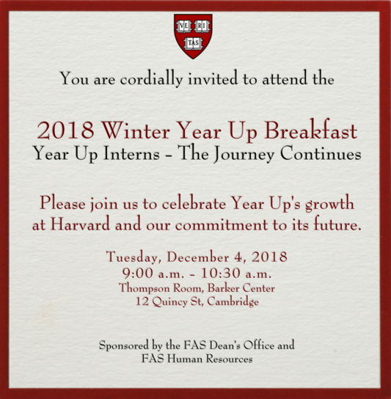

Slide 2
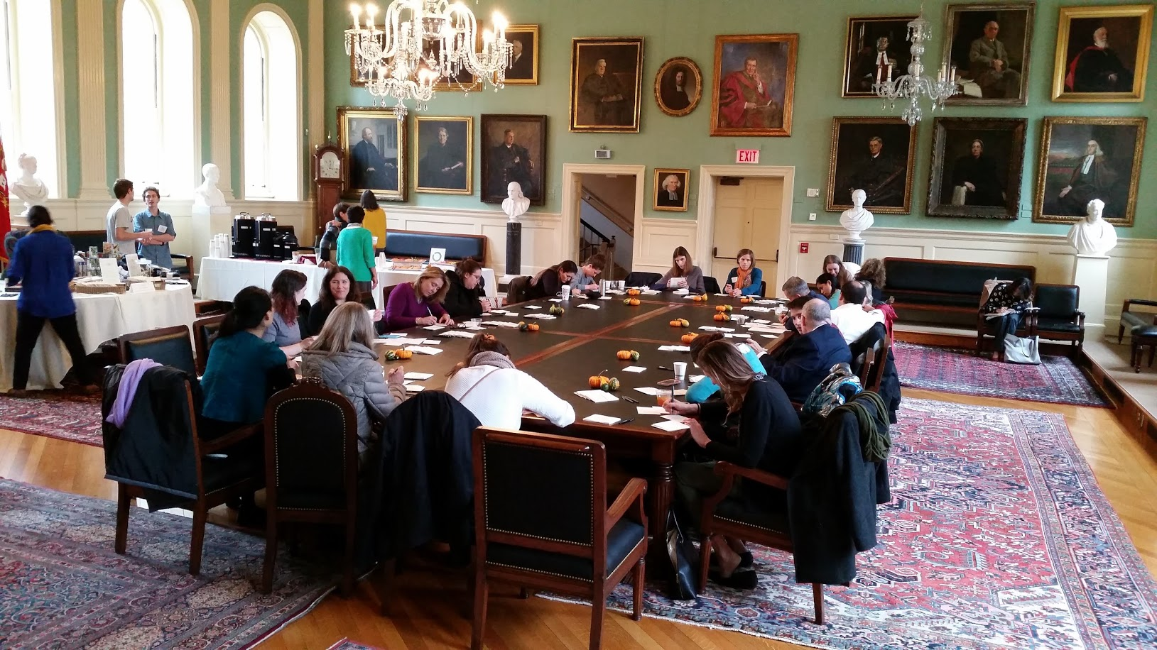
FAS Giving Thanks
Ninth annual FAS Giving Thanks Open House was held earlier this month.

Slide 3

FAS Dean’s Distinction
Tenth annual Dean’s Distinction
Honors the significant achievements and contributions of FAS staff members and teams
Nomination window opened on November 6 and will close tomorrow, November 30
Please use this opportunity to nominate a strong Dean’s Distinction candidate

Slide 4
FAS Administrators’ Town Hall
November 29, 2018
Fong Auditorium, Boylston Hall

Slide 5
Agenda
Connect with FAS Colleagues | Ticknor Lounge
Welcome, Introductions and Updates | Leslie Kirwan
Financial Update | Leslie Kirwan, Jay Herlihy
Harvard Library Overview | Anu Vedantham
ABC’s of B2P | Mary Ann Bradley, Andry McFall
HR Updates, New HUCTW Agreement | Chris Ciotti, Paul Curran
Closing / Q & A Session | Leslie Kirwan

Slide 6
Welcome, Introductions and General Updates
Leslie Kirwan
Dean for Administration and Finance

Slide 7
Financial Update
Leslie Kirwan, Jay Herlihy

Slide 8
Harvard Library Overview
Anu Vedantham
Director of Learning and Teaching Services,
FAS Libraries

Slide 9


Harvard Library Update
FAS Town Hall
Anu Vedantham
Director of Learning and Teaching Services for FAS Libraries
November 29, 2018

Slide 10
Compass
A student’s guide to Houghton Library
http://houghtoncompass.org/

Slide 11

http://library.Harvard.edu – New Library Website

Slide 12

FAS
Liaison Librarians
– find yours!

Slide 13
Senior Thesis Support

Slide 14
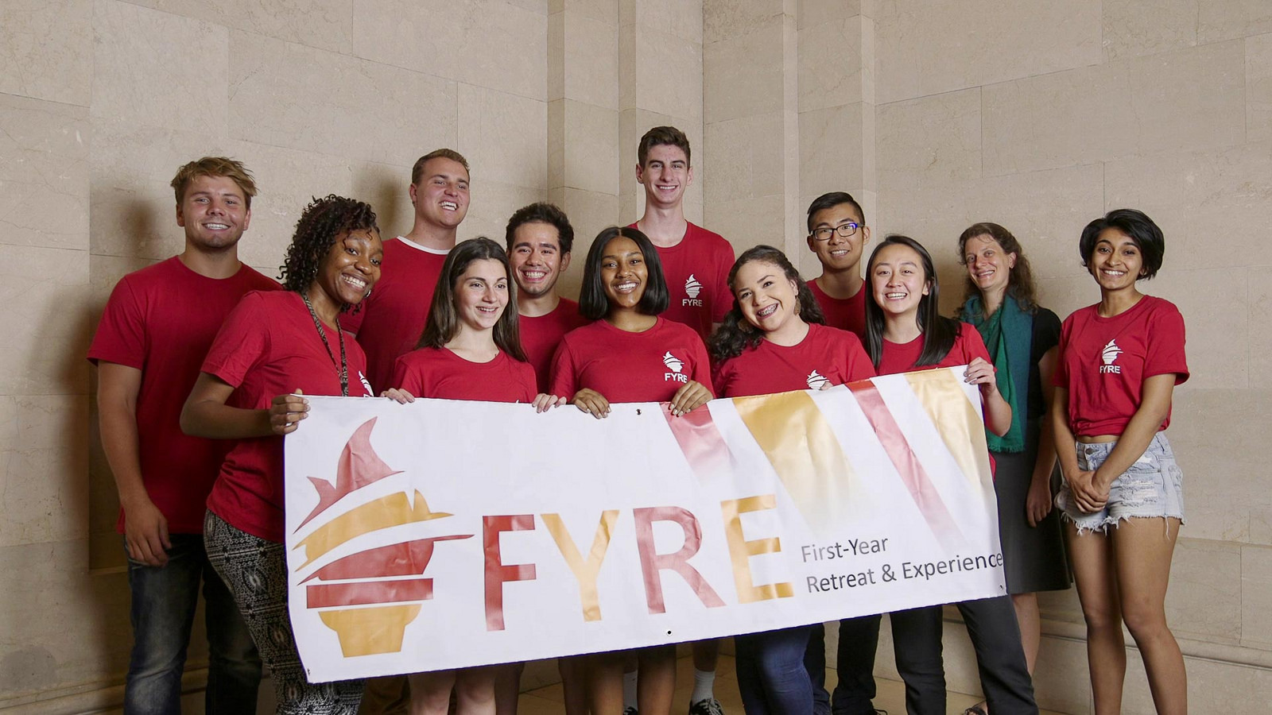
First Year Librarian Pilot 2018

Slide 15

http://tinyurl.com/hlpartners

Slide 16
Collect all
22 stickers!
“Let me know where my worn-down coffee-stained passport can be verified by a librarian.”
Harvard Library Passport
Created by the Peer Research Fellows

Slide 17
Questions?
Please contact Anu Vedantham at vedantham@harvard.edu
Widener Tumblr: http://widenerlibrary.tumblr.com/

Slide 18
ABC’s of Buy 2 Pay
Mary Ann Bradley
Associate Dean for Administrative Operations
Andry McFall
Manager of Procurement Operations,
FAS Administrative Operations

Slide 19

FAS Administrators’ Town Hall
November 29, 2018

Slide 20
FAS Engagement Council Members
 | Participant | Department |  | Participant | Department
1 | Andry McFall (Chair)* | Admin Ops | 12 | Rebecca Solari | Finance
2 | Katherine Gates (Co-chair)* | Admin Ops | 13 | Belinda Chu | GSAS
3 | Jason Jorgenson | Animal Care | 14 | Monica Oyama | HEB
4 | Christy Krant | Athletics | 15 | Shawn Lee | Hutchins Center
5 | Elizabeth Bean | CCB | 16 | Karen Rynne | Music
6 | Lisa Ball | CCB | 17 | Anna Salvato | OEB
7 | Amy Tsang | College | 18 | Jennifer Perry | Psychology
8 | Jim Barton | DCE | 19 | Nuala McGowan | RAS
9 | Marc Willis | DCE | 20 | Mike Holmes | Romance Language
10 | Edward Silva | Economics | 21 | Lenia Constantinou | Slavic
11 | Ann Gubnitsky | Finance | 22 | Amy Parker | Women, Gender & Sexuality
*Supported by the Admin Ops Team

Slide 21
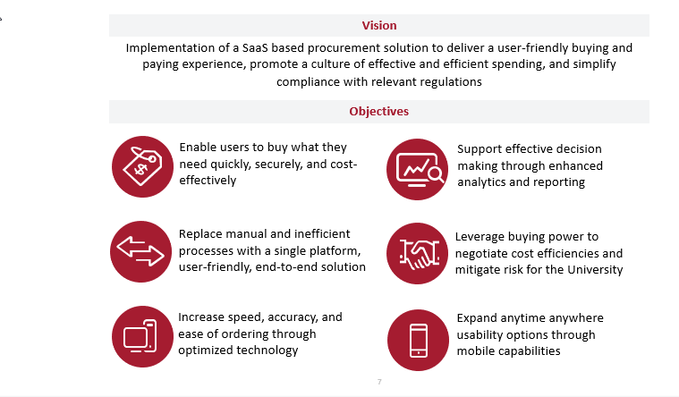
B2P Overview and Objectives

Slide 22






B2P Modules

Slide 23
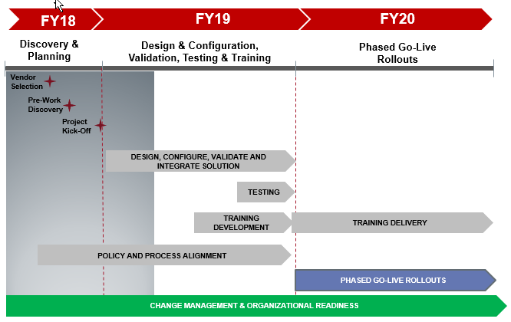
B2P Project Timeline

Slide 24
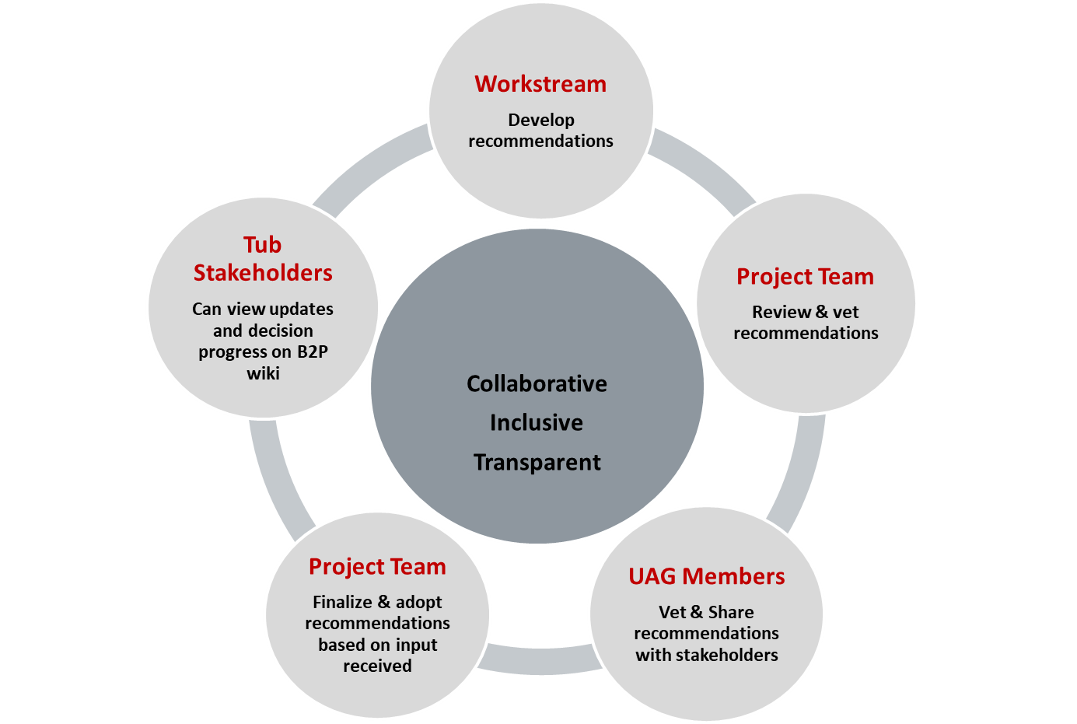
Collaborative Decision Making

Slide 25

B2P Work Streams
Work Streams | Team Leads
Supplier | Teri DeLeon
Approvals | Joyce Kaplan/Theresa Butler
Contracts | Elizabeth Copeland
Sourcing | Lauren Aiello
Integrations | Mary O’Brien
eProcurement | Teri DeLeon
AP | Teri DeLeon
Reporting & Analytics | Joyce Kaplan
Change Management | Karen Mancini

Slide 26
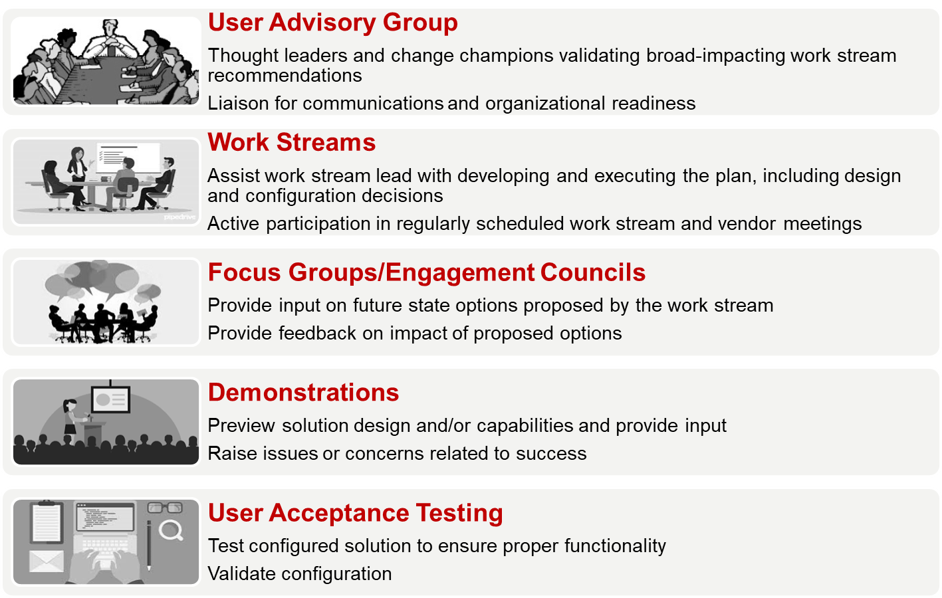
School Participation in B2P Project

Slide 27

Thank You!
https://wiki.harvard.edu/confluence/pages/viewpage.action?pageId=227879721

Slide 28
HR Update
Chris Ciotti
Associate Dean for Human Resources,
FAS Human Resources

Slide 29

Community Building: Faculty Assistants
There are close to 100 faculty assistants spread throughout 20+ departments at FAS.
Want to create opportunities to help make this community as inclusive and strong as possible.
Upcoming event focused on How to Negotiate When There is a Power Imbalance scheduled for Monday, January 14, 12:00 - 1:30 p.m. with lunch served
We ask for your flexibly in being supportive of faculty assistants attending this program

Slide 30
FAS HR Offerings: Upcoming Sessions
Putting Your Best Foot Forward: Tips for FAS Internal Candidates
April 10, 2019 (one remaining session)
Help Shape Our FAS Community: Listen, Learn, and Use Your Voice
Using Your Voice: Enhancing Psychological Safety | December 17, 2018
Empowering Bystanders: Fostering Workplace Civility | January 30, 2019
Mindfulness (HHR)
Mindful Eating | December 11, 2018 and January 16, 2019
Managing Daily Stress | December 4, 2018

Slide 31
New HUCTW Agreement
Paul Curran
Director of Employee Relations and Labor Relations,
Office of Labor and Employee Relations

Slide 32

Wishing you all a peaceful Holiday season!

